Slide 1
A Content Delivery Network for Music
Integrate Rights and Media with Administration
Cut costs by Automation
Pay stakeholders in real-time
Promote Artists
Content directly to consumers

Slide 2
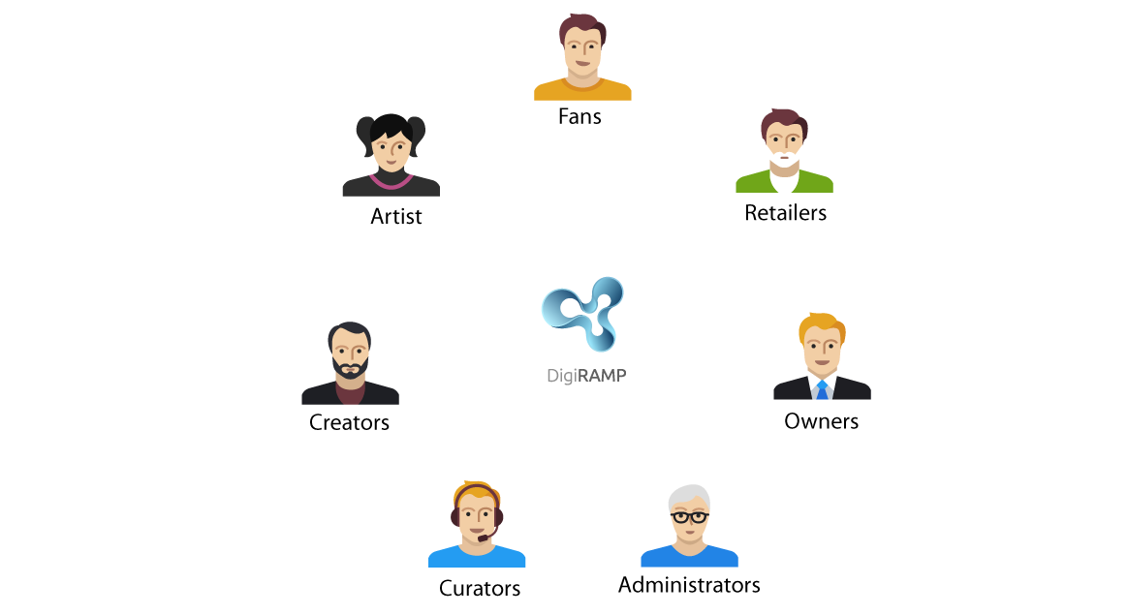
The eco-system
Listeners and fans
Influencers
Aspirational artists / Amateurs
Professionals
Brands and Advertisers
Creators
Owners
Administrators
And more …

Slide 3
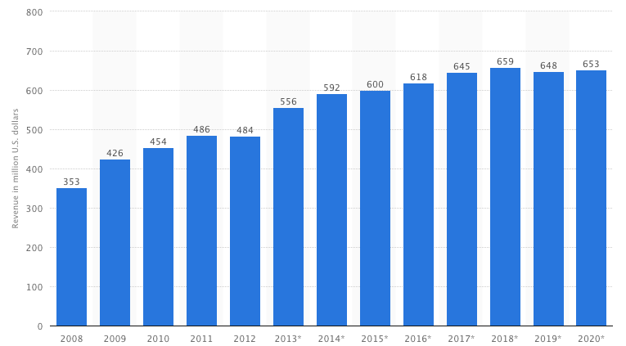
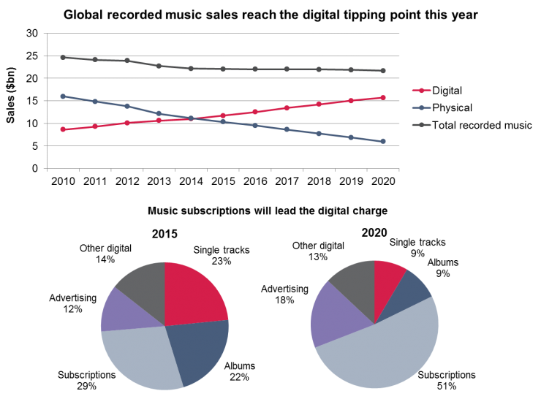
Market numbers
Production is climbing
Subscriptions is the future
More Music + Lower price pr. Song.
Less $ to the creators

Slide 4
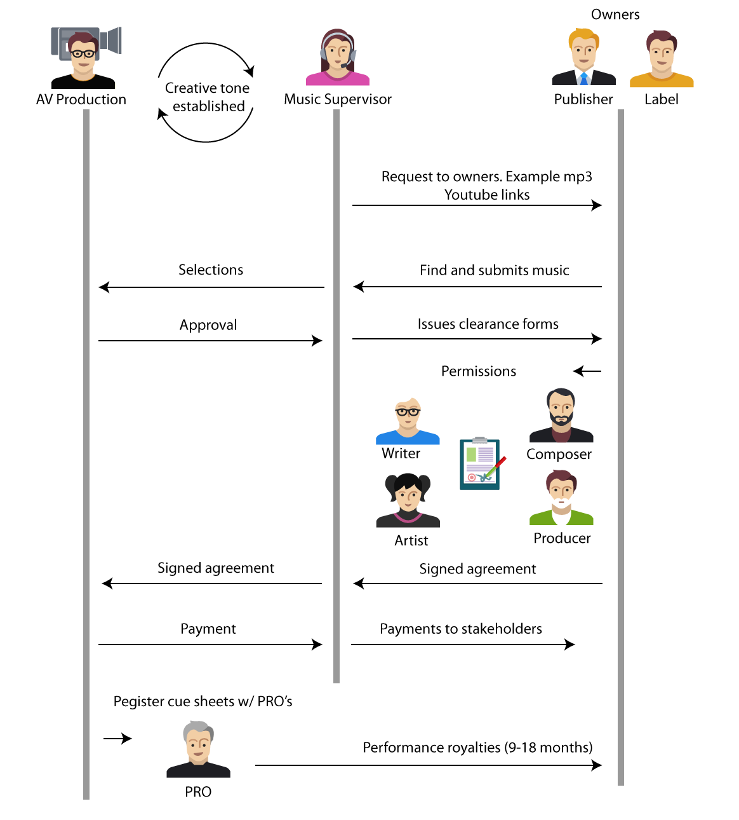
Not worth the effort (pain)
Lo budget
Lots of overhead
Slow
Responsibility in the wrong hands
Clearance missing

Slide 5
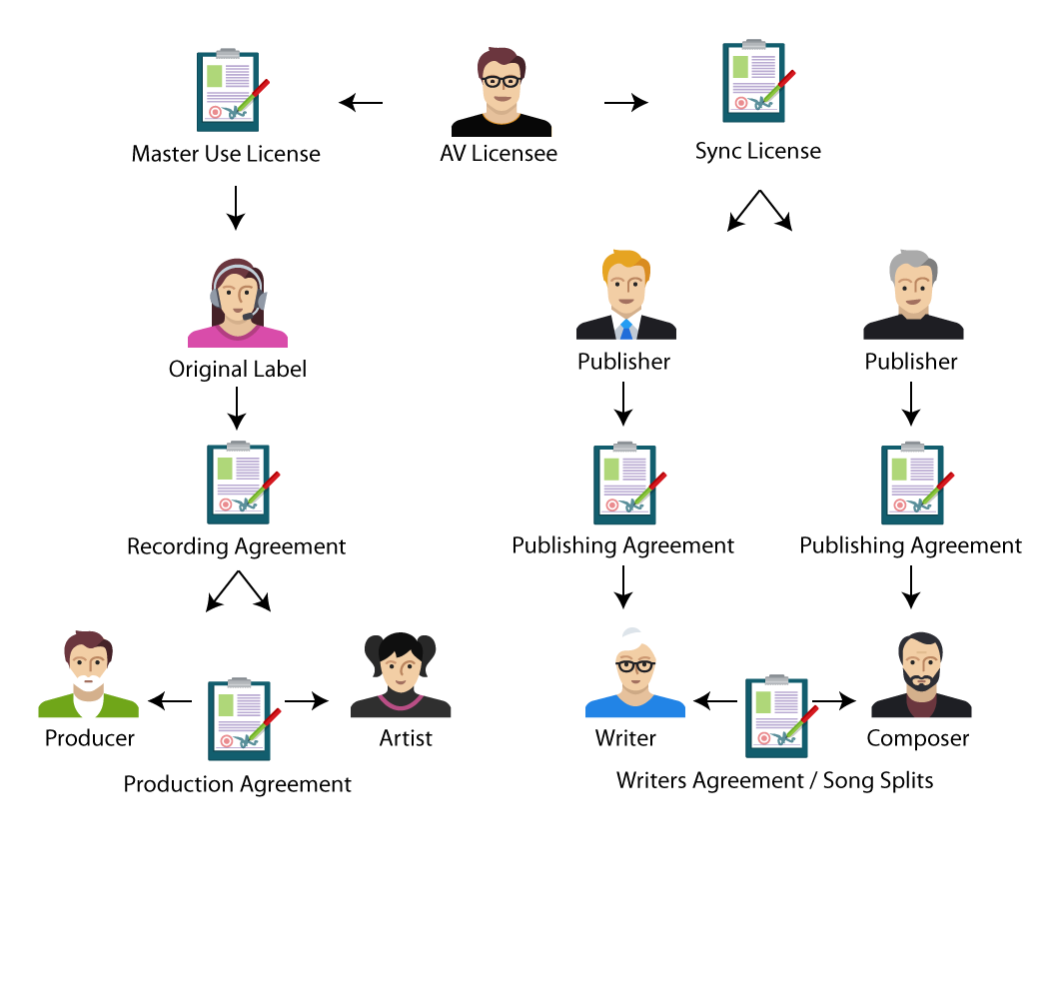
Automation (answer)
Self administration
Notification of IP’s
Documents and Digital signatures
Revenue streams and Payments
Content Delivery

Slide 6
Revenue streams
Shop / Curated products
Streaming
Licensing / Opportunities
Metrics / Analytics
Subscriptions
Advertising
Storage
Email campaigns
Publishing / Label / Administrating
PRO / Collections
Content delivery API / SDK / production library
Bundling
Plugins for DAW
Services / Legal / Help to import / Special features / Education
Books / Video
DigiRAMP become an Aggregator
Mobile apps
Campaign tool
Mastering
Music Hardware
Provide cleared music to hardware vendors’ game developers and third party streaming app true an API

Slide 7


Founders
Peter Rafelson
Music executive
Licensing expert
Publisher, Producer, Artist, Songwriter
Technologist
Max Grønlund
Software architect
Small high efficient teams
Industrial Tools and Technology
Passionate about supporting the creative

Slide 8
DigiRAMP is a hero brand.
DigiRAMP stand up against all the laws and traditions that prevent creators from getting a fair share for their work.
DigiRAMP respect the world as it is
More money to the creators no matter how little or how much
DigiRAMP do not exclude traditional players
Meet people where they are
Is open to the world
Lets user owns their life
Transparency and Accurate information’s

Slide 9
Keys to Success
Protection
Patents
Proprietary SW
Market share
Users
Content
B2B
Technology readiness
Scale unlimited
Fast
Independent from providers
Lean organization
Few employees
Low burn rate

Slide 10
Exit opportunities
Sales to another player in the industry.
Sale to a private equity partner

Slide 11
What’s the Deal
Amount we are looking for
6-12 month
Market dev
User experience dev
1 mill in Common share

